Slide 1
Software Engineering
By: M.Aamir Saleem
amir.saleem@gift.edu.pk

Slide 2
Software Testing Techniques
"Software testing techniques help you design better cases. Since exhaustive testing is not possible; testing techniques help reduce the number of test cases to be executed while increasing test coverage."
Static Testing Dynamic Testing
Review White box testing
Walk Through Black box
Inspection Gray Box

Slide 3
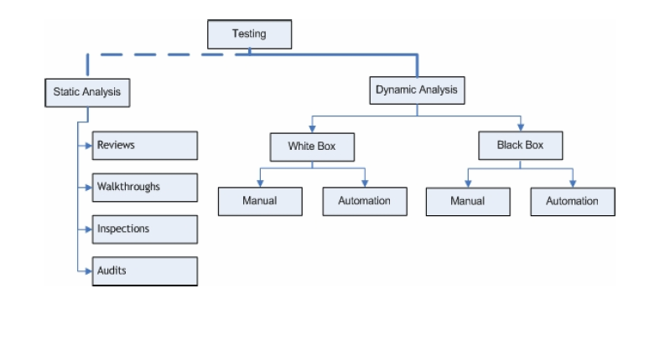
Software Testing Techniques

Slide 4
Review Types
Informal Technical Review
Walk Through
Inspection

Slide 5
Informal Technical Review
A discussion meeting
Focuses on technical content
Led by a trained moderator, but also can be led by a technical expert
Little or no focus on defect identification on the basis of referenced documents
Performed as a peer review without management participation

Slide 6
Walk Through
Not a formal process
Led by the authors
Useful for higher level documents
Evaluate the contents of the document
Achieve a common understanding
Discuss the validity of the proposed solutions
Get feed back

Slide 7
Review
Formal Technical Review
SQA Activity
Conducted by technical staff
Making system error free
Make sure system under review meets requirements
Maintain standard

Slide 8
Formal Review Participants
Author: Takes responsibility for fixing the defect found and improves the quality of the document
Moderator: Performs entry check, follow up on rework, coaching team member, schedule the meeting.
Reviewer: Check material for defects and inspects
Scribe: It does the logging of the defect during review and attends the review meeting

Slide 9
Phases of a formal Review
Planning: Request for review, document size, pages to be checked, composition of review team, roles of each participant
Kickoff: Role assignments, checking rate, the pages to be checked, process changes and possible other questions, distribution of the document under review, source documents and other related documentation
Preparation: Participants check document under review using the related documents, procedures, rules and checklists, to identify defects, questions and comments.
Meeting: logging phase-discussion phase-decision phase
Rework: Decide on the execution of reviews and ensures the review process objectives are met.
Follow-Up: Ensure that satisfactory actions have been taken on all logged defects, Participants will check the updated document

Slide 10
Inspection
Most formal review type
Led by the trained moderators
Use entry and exit criteria
Documents are prepared and checked thoroughly by the reviewers before the meeting
Involves higher management to examine the product
A separate preparation is carried out
Defects are logged
Formal follow-up

Slide 11
Software Testing Techniques
White Box
Statement Coverage
Branch Coverage
Path Coverage

Slide 12

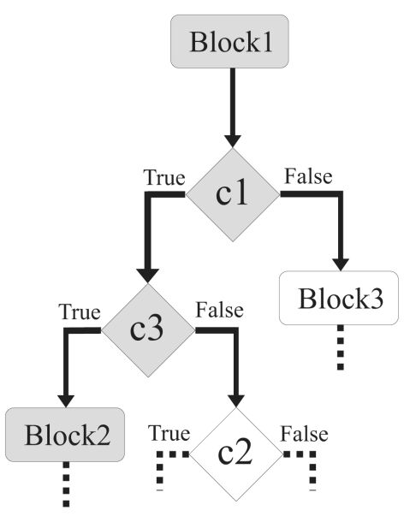
Software Testing Techniques
White Box
Branch coverage
Path Coverage

Slide 13
Software Testing Life Cycle
Gray Box Testing
A combination of Black Box and White Box testing methodologies, testing a piece of software against its specification but using some knowledge of its internal workings.
Some knowledge of internal code and structures
Pattern Testing
Regression testing

Slide 14
Software Testing Techniques
Black Box Testing
Tests are done from a user’s point of view
Tester need not know programming language
Testing is independent from dev team
Only a small number of possible inputs can be tested
Tests can be redundant
Levels to implement: Integration, System and acceptance testing

